Slide 1
MyMovez data analysis
Eric Araújo, Bojan Simoski, Michel Klein
Last update: 05 February 2018

Slide 2
Summary
Overall information about the data collection
Connections
Personality Traits
Agents connections
Agents characteristics
PA
Snacking
BMI
Environment
The model presented by Giabanelli (2012)
The model based on Beheshti (2017)

Slide 3
Overall information

Slide 4
Phase I – MyMovez project
N = 953
Two cohorts
8-12 y/o
12-15 y/o
21 primary and secondary schools in the NL
Five (5) waves from 2016-2018
W1: 02/2016
W2: 04/2016
W3: 06/2016
W4: 02/2017
W5: 02/2018

Slide 5
Participants per wave
W1: 792
W2: 852
W3: 824
W4: 671
W5: ?

Slide 6
Measurements
Self-report survey (short digital questionnaires via smartphones)
Objective measures
Cycling
Photos
Real-time data
Activity tracking
Social Beacon Network
Social Buzz data
Research-assessed measures (weight and height)
Measures for weight, height were made on W2, W4 and W5. (yearly basis)

Slide 7
Connections
Measures for connections in the data set

Slide 8
Sociometric questions
The connections are created based on nominations.
The kids were asked to chose 16 peer nomination items during the course of the research week (appx 3 questions per day)
Nominate at least one person per item. More than one is permitted.
Participants can nominate kids not in the experiment.
Participants can’t nominate themselves.

Slide 9
Questions
(Variables) Questions
(GEN_Friendship) Who are your friends?
(GEN_Advice) Who do you ask for advice?
(GEN_Leader) Who are the leaders or take the position of leader in a group?
(GEN_Respect) Who do you respect?
(GEN_Social_Facilitation) With whom do you spend time?
(GEN_INNOV_REV) [NOT FOUND IN DS] Who often has new gadgets and clothes? (+)
(GEN_Want2B) Whom do others want to look like? (+)
(DI_Com_Network) With whom do you talk about what they eat and drink?
(DI_Modelling) Who eats or drinks products that you would like to eat or drink?
(DI_Modelling_reversed) [NOT FOUND IN DS] For who do you are an example in eating and drinking healthy?
(DI_Impression_management) Of whom do you think it is important that they see you as someone who eats and drink healthly?
(PA_Impression_Management) Of whom do you think it is important that they see you as someone who is physically active?
(PA_Com_Network) Who do you talk about physical activity and sports?
(PA_Modelling) Who are exercising in a way you also want to exercise?
(PA_Modelling_reversed) [NOT FOUND IN DS] For who are you an example in sports?
(ME_Com_Network) With whom do you talk about what do you see on TV or internet?

Slide 10
Setups for connections
3 networks were built
All questions
GEN questions
Only Friendship question

Slide 11
Distribution of the nominations per questions set

Slide 12
Degree distribution of the nominations

Slide 13
Hamming distance
Hamming distance --------------------------------------------------------------------------------------------------- Class All x Gen Gen x Friend All x Friend --------------------------------------------------------------------------------------------------- 67 0.08 0.22 0.30 71 0.06 0.36 0.41 72 0.14 0.32 0.46 74 0.02 0.15 0.17 77 0.06 0.17 0.24 78 0.04 0.22 0.26 79 0.05 0.15 0.20 81 0.07 0.24 0.31 83 0.09 0.18 0.27 86 0.00 0.10 0.10 100 0.03 0.30 0.33 101 0.09 0.14 0.23 103 0.08 0.18 0.26 121 0.05 0.26 0.30 122 0.07 0.26 0.34 125 0.04 0.21 0.25 126 0.00 0.17 0.17 127 0.07 0.23 0.30 129 0.05 0.27 0.32 130 0.11 0.29 0.40 131 0.14 0.24 0.37 133 0.09 0.20 0.29 135 0.02 0.27 0.29 136 0.08 0.27 0.35 138 0.03 0.24 0.27 139 0.14 0.33 0.47 ---------------------------------------------------------------------------------------------------

Slide 14
Personality traits
Measures for traits in the data set

Slide 15
Demographics
Age
Sex
Grade level
Nationality
Caregivers’ nationalities
Figure rating (FRS)
Older and younger, male or female siblings

Slide 16
Personality traits (1/?)
Self-esteem
10-item questionnaire (by Rosenberg) measuring negative and positive thoughts about oneself
“How often…” participants felt worthy or not about themselves
Scale from Never (1) to Always (6)
Body-esteem
Figure Rating Scale (FRS) from very thin (1) to obese (9)
Score below 0 indicates lower body esteem
Score equals indicates satisfaction with the body
Scales above 0 indicates body dissatisfaction (for boys, it indicates they want to be more muscular)

Slide 17
Personality traits (2/?)
Need to belong (LTB)

Slide 18
BMI
BMI = weight(kg)/height(m)²
z-BMI standard
Standardized BMI-scores (using LMS-method)
Notes:
There are two different calculations for BMI. In the file Thabo send you there is one called zBMI and one called BMIcor. The variable zBMI is calculated based on the LMS method (where they take into account that the for each each there is a different BMI). The BMIcor is where we classified the children based on Dutch scores in five categories, namely 1 = severe underweight, 2 = underweight, 3 = healthy weight, 4 = overweight, 5 = severe overweight).
We used the following table to calculate the categories http://www.voedingscentrum.nl/professionals/kindervoeding-0-4-jaar/babyenkindervoeding/bmi-jongens-en-meisjes.aspx. You could use this variable for your model.
Greets,
Crystal

Slide 19
BMI, height and weight
http://www.who.int/growthref/who2007_bmi_for_age/en/
http://kidshealth.org/en/parents/bmi-charts.html

Slide 20
Socioeconomic status
Family Affluence Scale (FAS II)
# of computers, laptops or tablets
# of cars
# of bathrooms in the household
# of holidays the family could afford each year.
If the kids have their own bedroom (+)
If there is a dishwasher in their household (+)
Postal code (neighborhoods are classified by Statistics Netherlands)

Slide 21
Agents Connections
How the connections were built for the simulations

Slide 22
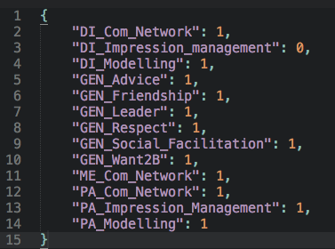
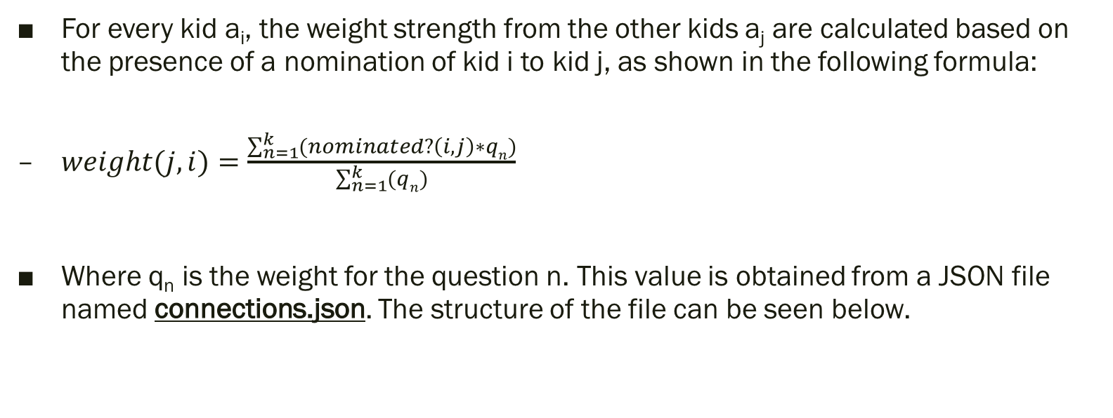
Formula
For every kid a_{i}, the weight strength from the other kids a_{j} are calculated based on the presence of a nomination of kid i to kid j, as shown in the following formula:
$weight(j,i)=\frac{\sum_{n=1}^{k}{(nominated?\left(i,j\right)∗qn})}{\sum_{n=1}^{k}{(qn})}$
Where q_{n} is the weight for the question n. This value is obtained from a JSON file named connections.json. The structure of the file can be seen below.

Slide 23
Potential works with the connections
Verify the multiple possibilities of networks and verify which one is more representative of the real network.
Use different sets of questions to infer the network and verify the impact in the simulation results.
All questions
GEN questions
Only Friendship

Slide 24
Discussion points
There are answers for 3 waves (1, 2 and 3) but not for the 4th wave. Is this missing data expected?
How to build networks with a time dimension and a personal bias?
So far, all the nominations for all the waves are brought together.

Slide 25
Agents Characteristics
How the information of the agents was included in the network

Slide 26
Physical Activity (PA)
The Physical Activities were measured in number of steps and minutes of moderate to vigorous activity (MVPA).
The file contains the numbers for the steps, MVPA and the imputed version of them. The imputed version was used.
The fitbit information provides the start and finish dates for each wave (4765 data points)
5 data points per kid per wave.
W1: 2016-01-27 to 2016-02-02
W2: 2016-03-30 to 2016-04-05
W3: 2016-06-02 to 2016-06-08
W4: 2017-02-14 to 2017-02-20

Slide 27
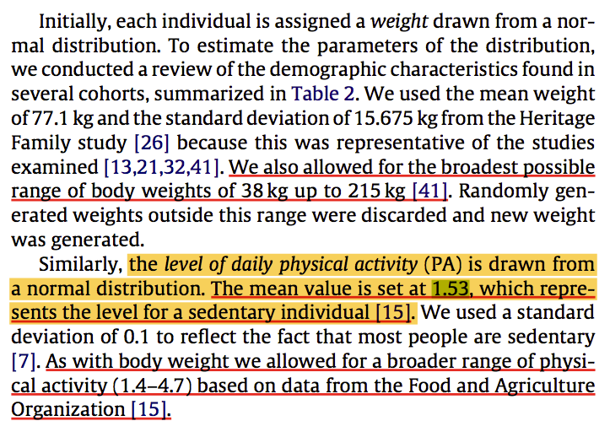
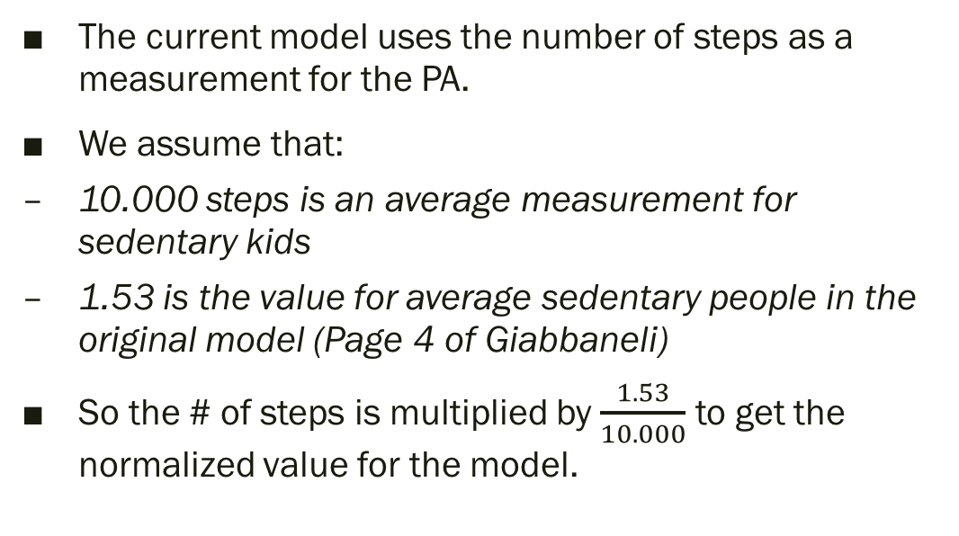
PA Steps
The current model uses the number of steps as a measurement for the PA.
We assume that:
10.000 steps is an average measurement for sedentary kids
1.53 is the value for average sedentary people in the original model (Page 4 of Giabbaneli)
So the # of steps is multiplied by $\frac{1.53}{10.000}$ to get the normalized value for the model.

Slide 28
PA distribution

Slide 29
Discussion points (PA)
I’ve noticed that some kids have different dates for their PA calculation. How does it work?
Steps or MVPA?
How to calibrate the level of sedentary kids?

Slide 30
Age, gender
Age is measured in all the waves, but it is not changing for participant 643, for instance. Is it updated or not?

Slide 31
Discussions
30/01
Thabo & Crystal are going to send me a paper to calculate the environment based on the data sent before.
BMI table was sent by Crystal on 6/2

Slide 32
Class
The class can be the same or change from Y1 to Y2, according to the pp.csv file.
Invert the logic
I took the classes from Y2 as the starting point.

Slide 33
Discussion points (Class)
Shall we consider the Y2 as the original point, as it is the most recent information? Or shall we consider Y1, as the changes might have dropped up some kids from the experiment?
From the classes selected, only two kids with missing data on Y2 belong to class 71.

Slide 34
Environment
Calculated based on FAS II.

Slide 35
Original Model
Model presented by Beheshti et al. 2017

Slide 36
ABM structure
The model assumes that the following factors determine diffusion intervention effects throughout a population:
Personal characteristics of the actors;
Social network ties and social influence;
The role of environmental factors.

Slide 37
Selection of interventions
15% of reduction in total kcals of consumption
17% of physical activity increase.

Slide 38
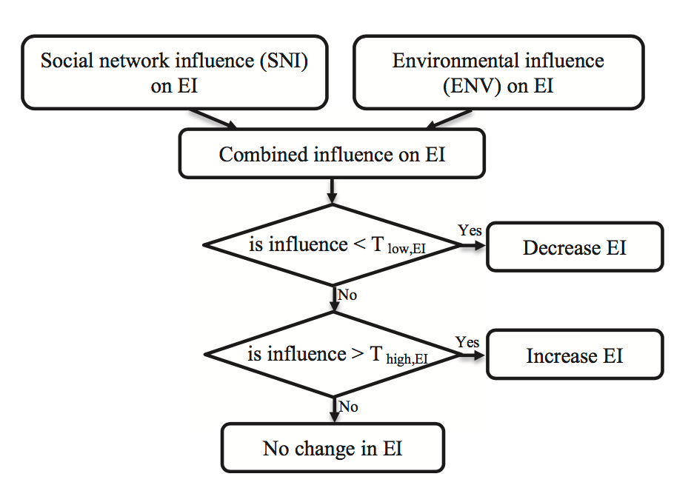
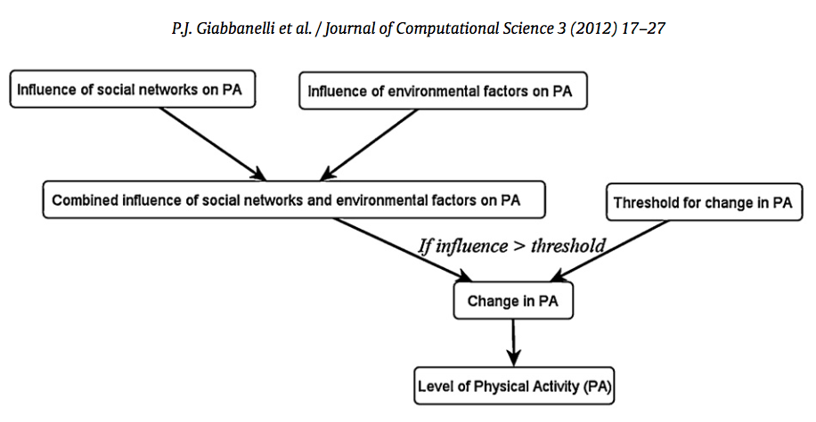
The diffusion model
“… the social diffusion dynamics that are assumed for the propagations of behavior change and obesity in a social network.”

Slide 39
The model
The difference between energy intake (EI) and energy expenditure (EE) define the energy imbalance (EIB) and determines the body weight changes over time.
A fixed energy of 32.2 MJ/Kg is used for energy surplus turning to body-weight
A person gains 1kg for every extra 32.3MJ
BMI is calculated assuming the height is fixed.
ORIGINAL MODEL
SNI (social network influence) is based on the agents’ friends physical activity and energy intake.
ENV (environment) is a fixed value distributed randomly.
SNI and ENV are combined and compared to a threshold (fixed to all agents)
If the combination is greater than the threshold: agent changes EI or PA (accordingly)
If the combination is lower than the threshold: no changes.

Slide 40
Modifications in the model
Low and high threshold
If the combined influence is smaller than the low threshold for EI, agent will decrease EI.
If the combined influence is larger than the high threshold for EI, agent will increase EI.
If the combined influence is smaller than the low threshold for PA, agent will decrease PA.
If the combined influence is larger than the high threshold for PA, agent will increase PA.
ENV is different for every node.
Lower values = healthier environments
Values ranging from 0.93 to 1.02.
Changes in the calculation of the energy surplus/deficit to weight change
Couldn’t find this formula in the code…

Slide 41
Network
Built using power law degree distribution and homophily properties.

Slide 42
Interventions
Targeted 10 percent of the population
Random
High-risk (overweight adults)
Vulnerable (environment)
Most connected
Most influential

Slide 43
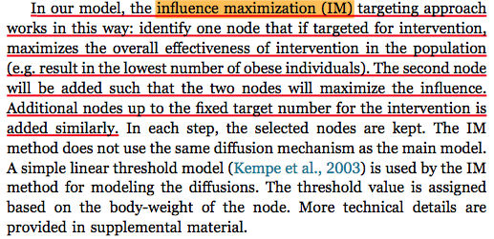
Most influential

Slide 44
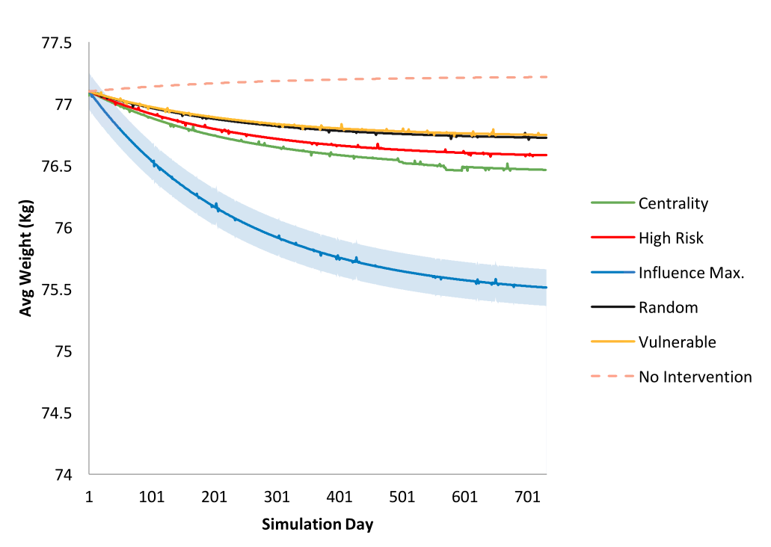
Results of the simulation by Beheshti et al.

Slide 45
Results of simulations with mymovez data
The simulations performed using our methods

Slide 46
Cluster 0

Slide 47
Cluster 0

Slide 48
Cluster 0

Slide 49
Cluster 0: No interventions

Slide 50
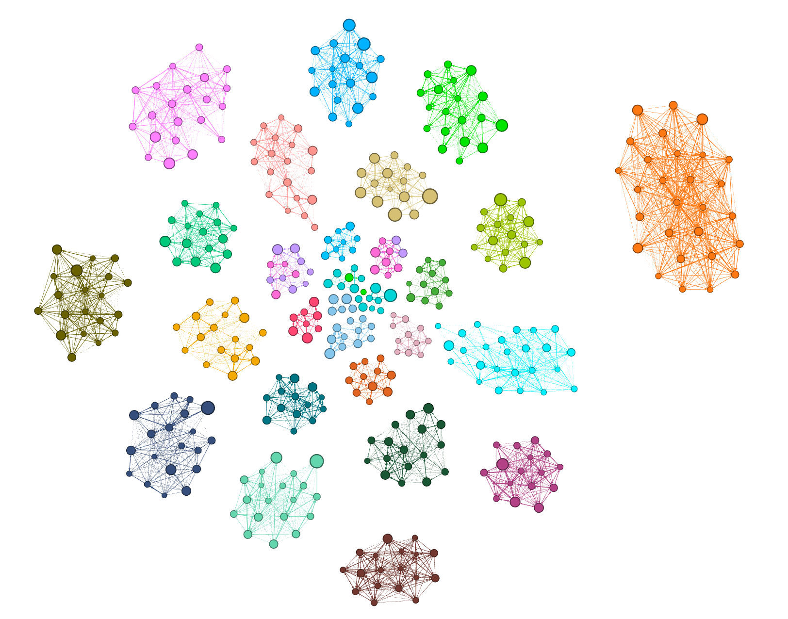
Full graph

Slide 51
Full graph

Slide 52
Full graph

Slide 53
Full graph

Slide 54
Meetings
Decisions after meetings and future steps

Slide 55
30-01-2018
A paper on BMI metrics is going to be sent to Eric
Environment metrics are going to be sent to Eric
Defining which questions are important for the connections can be based on:
One question (friendship) alone
6 questions (GEN)
All the questions
For the class, take the Y1 class, and fill the missing data with Y2
Interventions should be applied for 10%, 20% or 15%, 25% or 2,4 and 6 kids

